Slide 1
Healthcare Management Data Analysis
This project analyzes hospital operations using patient, doctor, appointment, treatment, and billing datasets. It provides insights into appointment trends, treatment costs, doctor performance, and payment patterns to improve decision-making and healthcare efficiency.

Slide 2
Explore the Data using Excel. Understand the data and prepare a short summary about the dataset.
Appointments Sheet: Tracks patient appointments with details such as appointment ID, patient ID, doctor ID, date, reason for visit (e.g., therapy, checkup, consultation), appointment status (Scheduled, Completed, Cancelled, No-show), and No-show flag.
Patients Sheet: Contains patient demographics, including patient ID, gender, address, registration date, insurance provider, full name, and age.
Doctors Sheet: Includes information about doctors such as doctor ID, specialization (Dermatology, Pediatrics, Oncology, etc.), years of experience, hospital branch, and full name.
Treatments Sheet: Records treatments linked to appointments. Each treatment entry has a treatment ID, appointment ID, treatment type (Chemotherapy, MRI, X-Ray, etc.), description, cost, and treatment date.
Billing Sheet: Manages billing information with bill ID, patient ID, treatment ID, bill date, amount, payment method (Insurance, Cash, Credit Card), payment status (Paid, Pending, Failed), and completion status.
👉 Overall, this dataset provides a comprehensive view of hospital operations, covering patient demographics, doctor details, appointments, treatments, and billing. It can be used for healthcare analytics, such as analyzing appointment trends, patient demographics, doctor workloads, treatment costs, billing/payment patterns, and no-show rates.

Slide 3
Perform Data cleaning if required and then do Statistical Analysis on data using statistical tools.
In Appointments sheet, deleted the Appointment Time column as it was not required.
In Treatments sheet, rounded the Cost column to 0 decimals for consistency.
In Patients sheet, removed columns (First Name, Last Name, Insurance Number, Email, Contact Number) and created a single Full Name column.
In Doctors sheet, removed columns (First Name, Last Name, Phone Number, Email) and created a single Full Name column.
✨ This ensures a clean, consistent, and analysis-ready dataset.

Slide 4
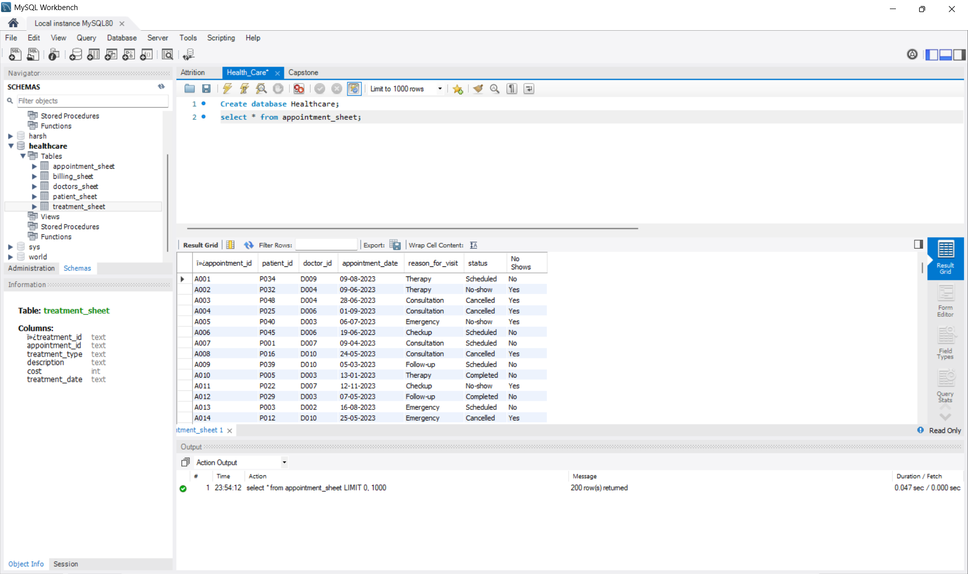
Insert the given data into the SQL server by making a Database and defining the Required parameters for the construction of Database and Database tables.

Slide 5
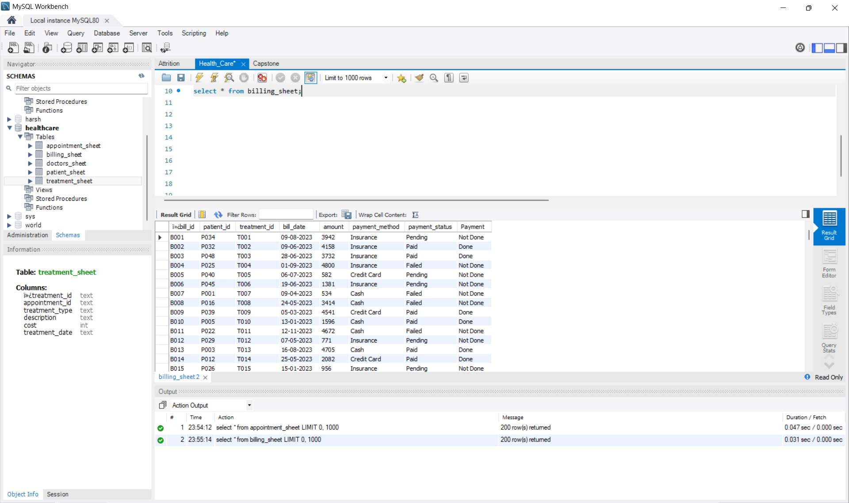

Slide 6
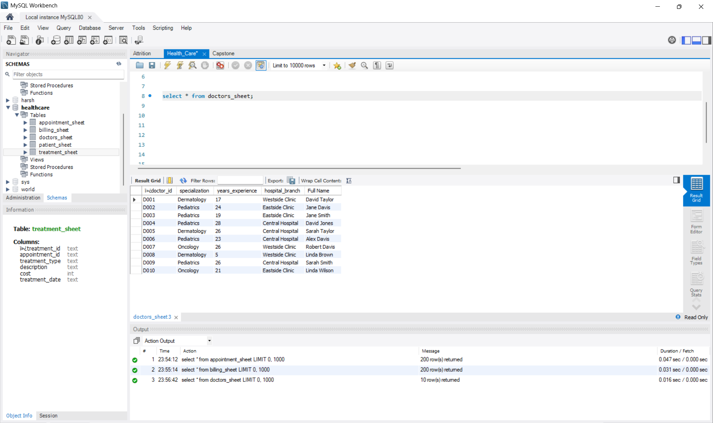

Slide 7
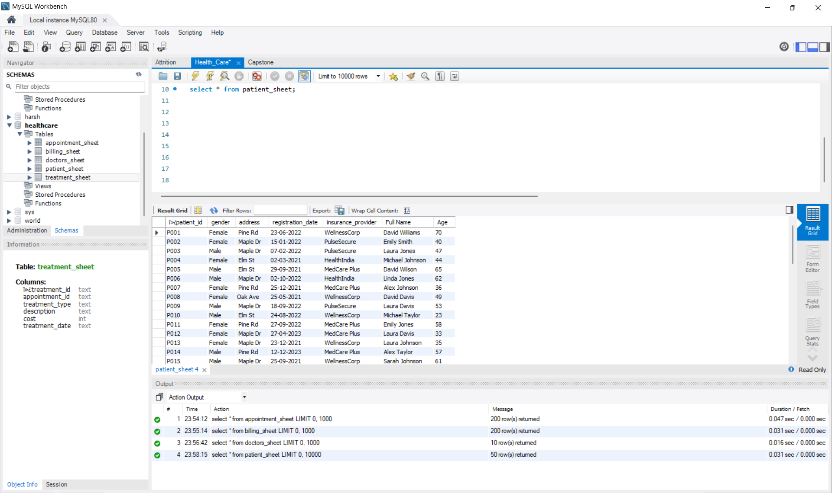

Slide 8
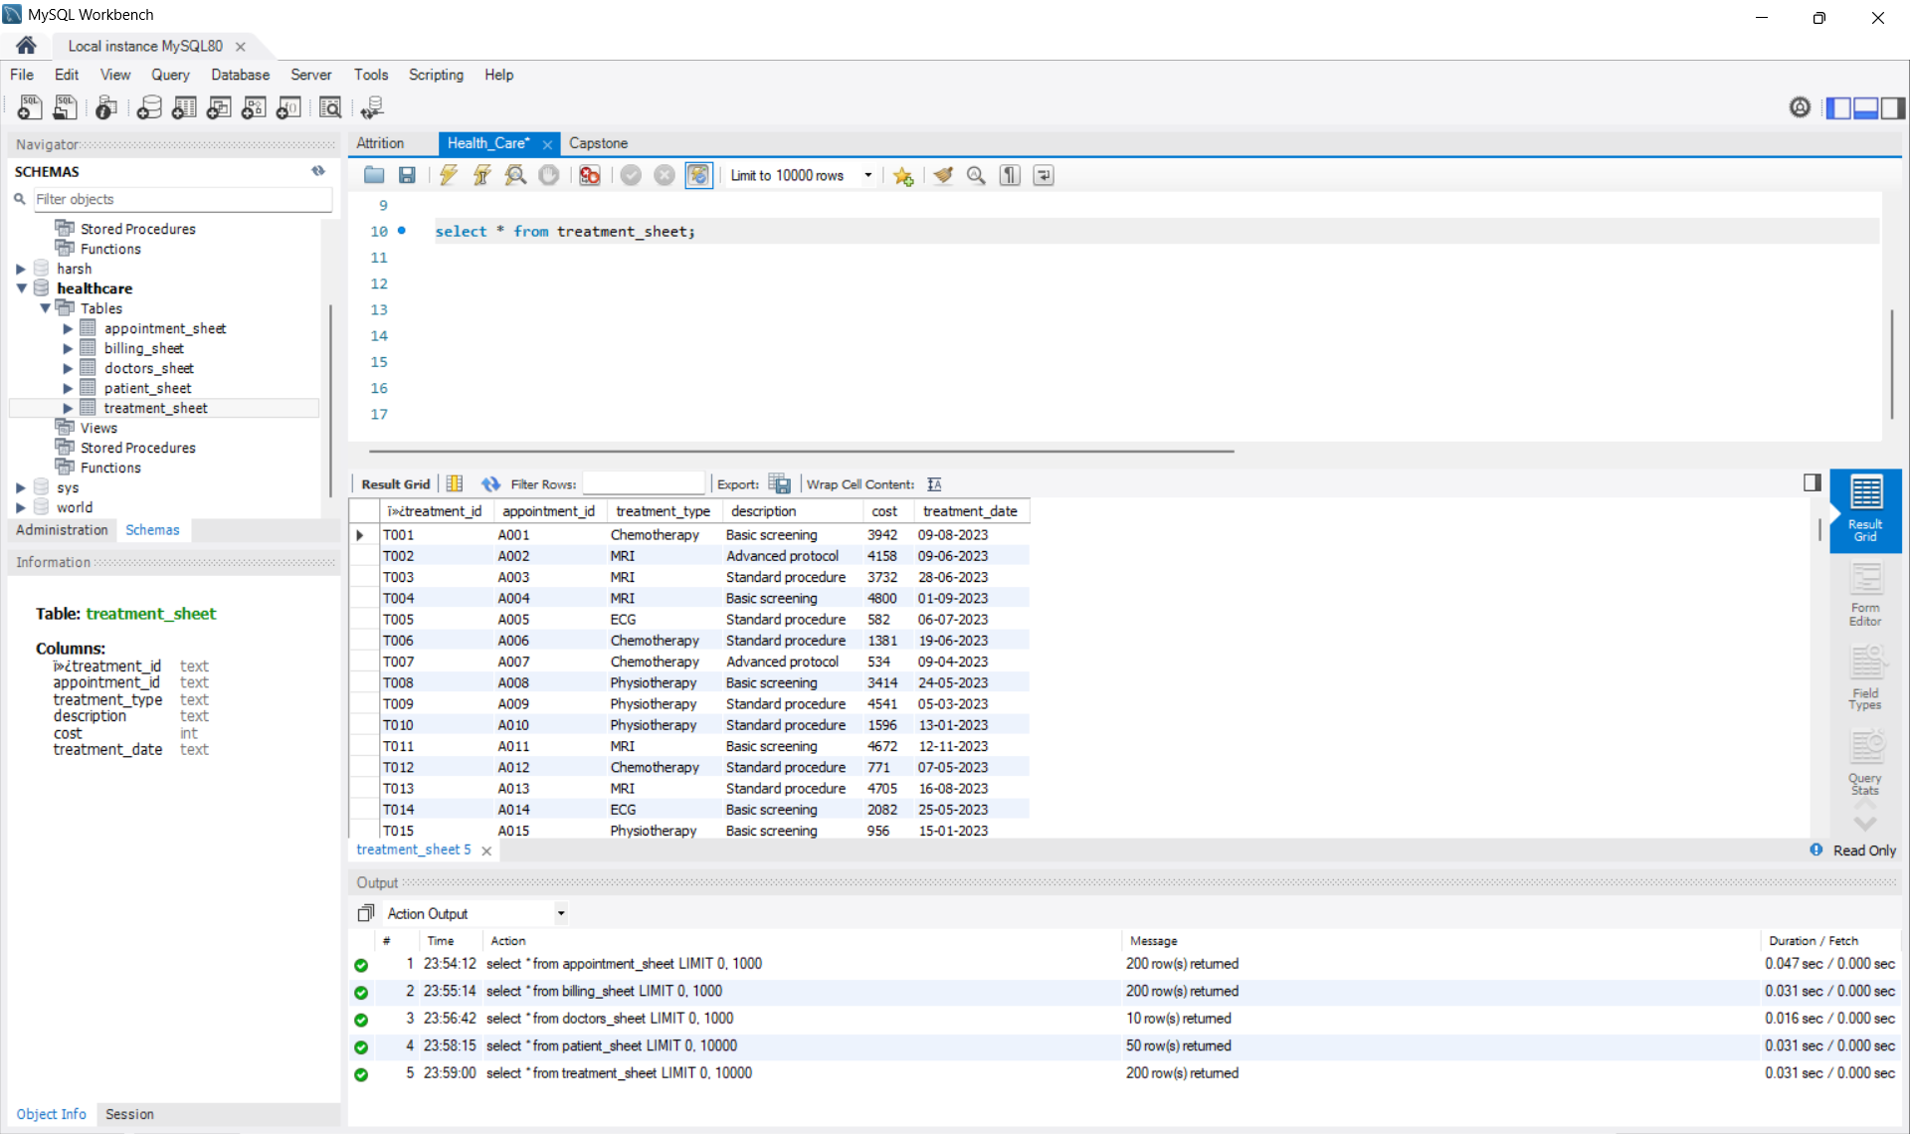

Slide 9
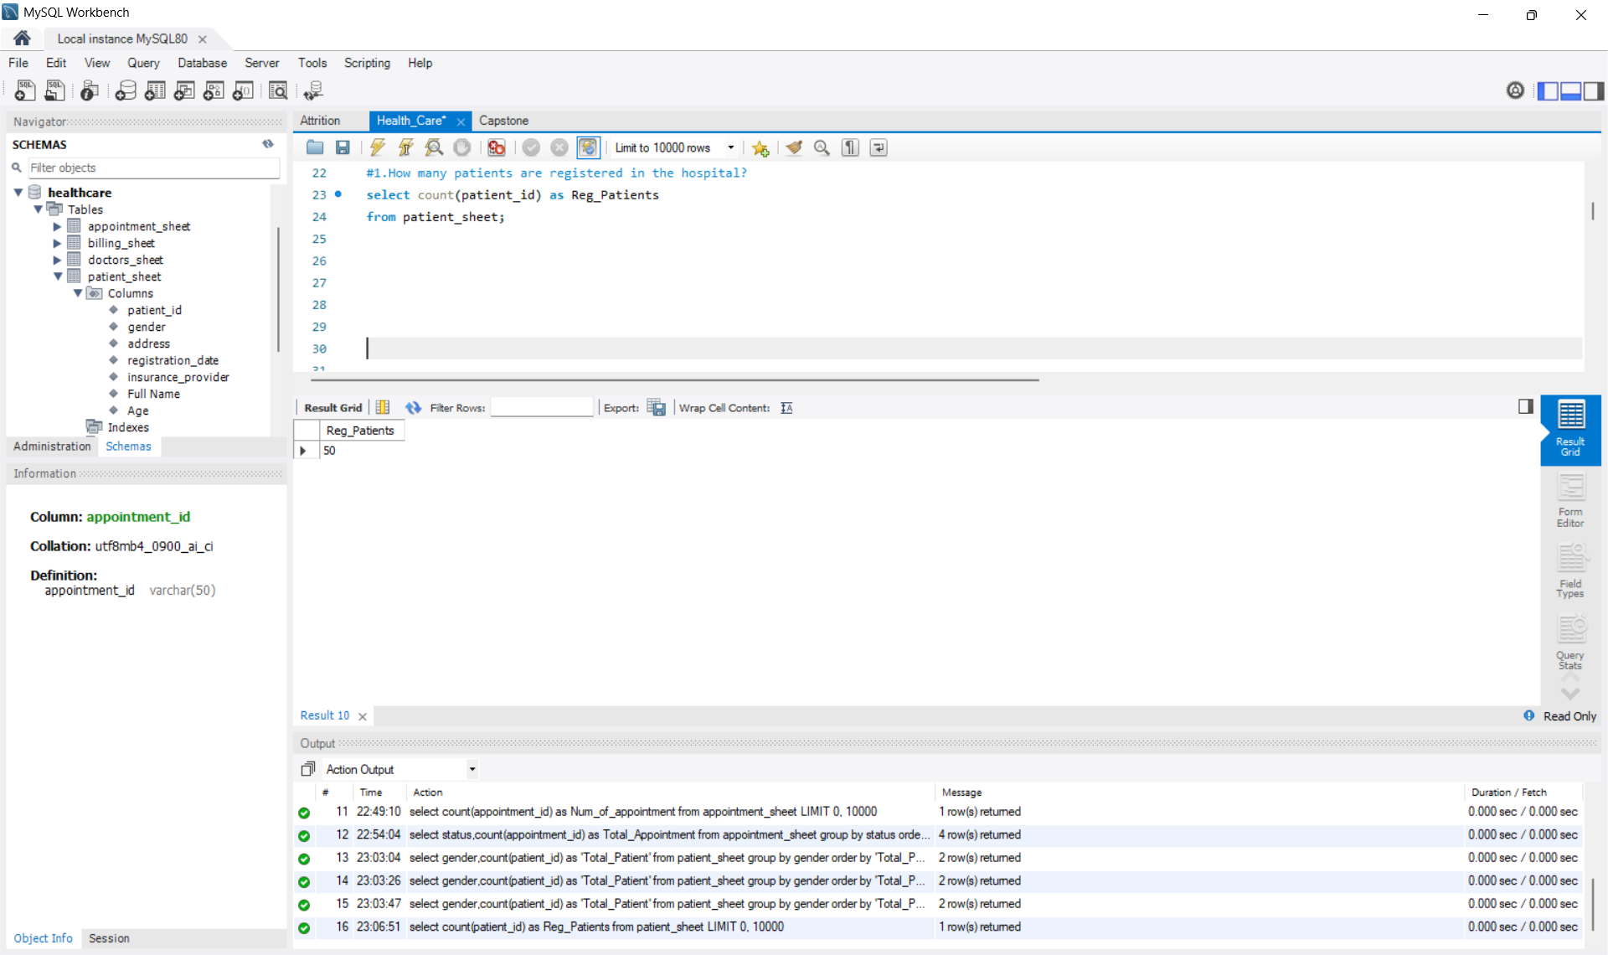
Verify if the data is properly imported into the SQL database (Try running few Queries).

Slide 10
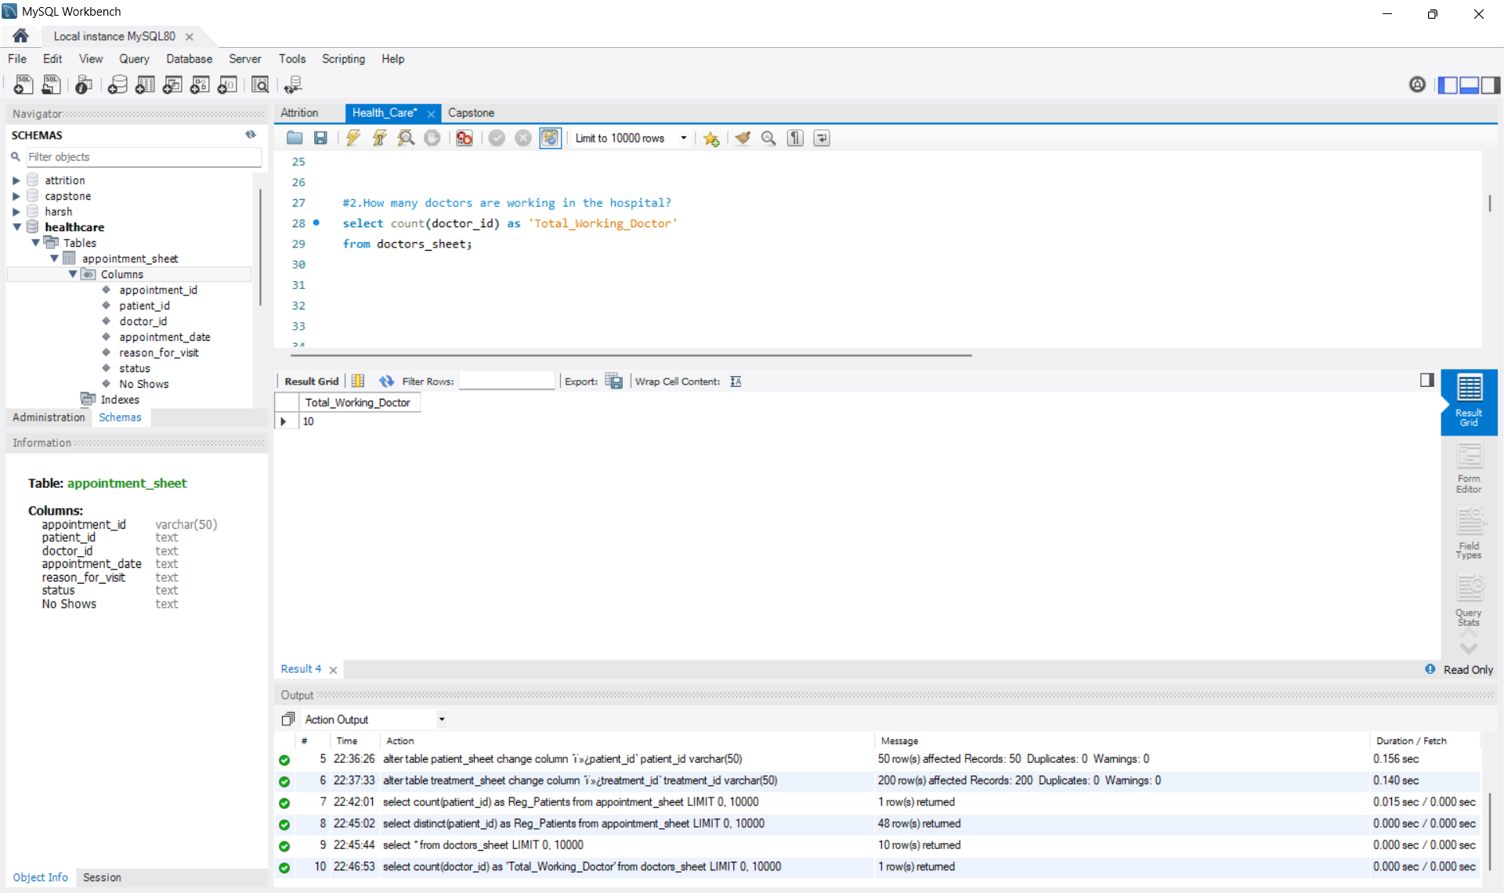

Slide 11
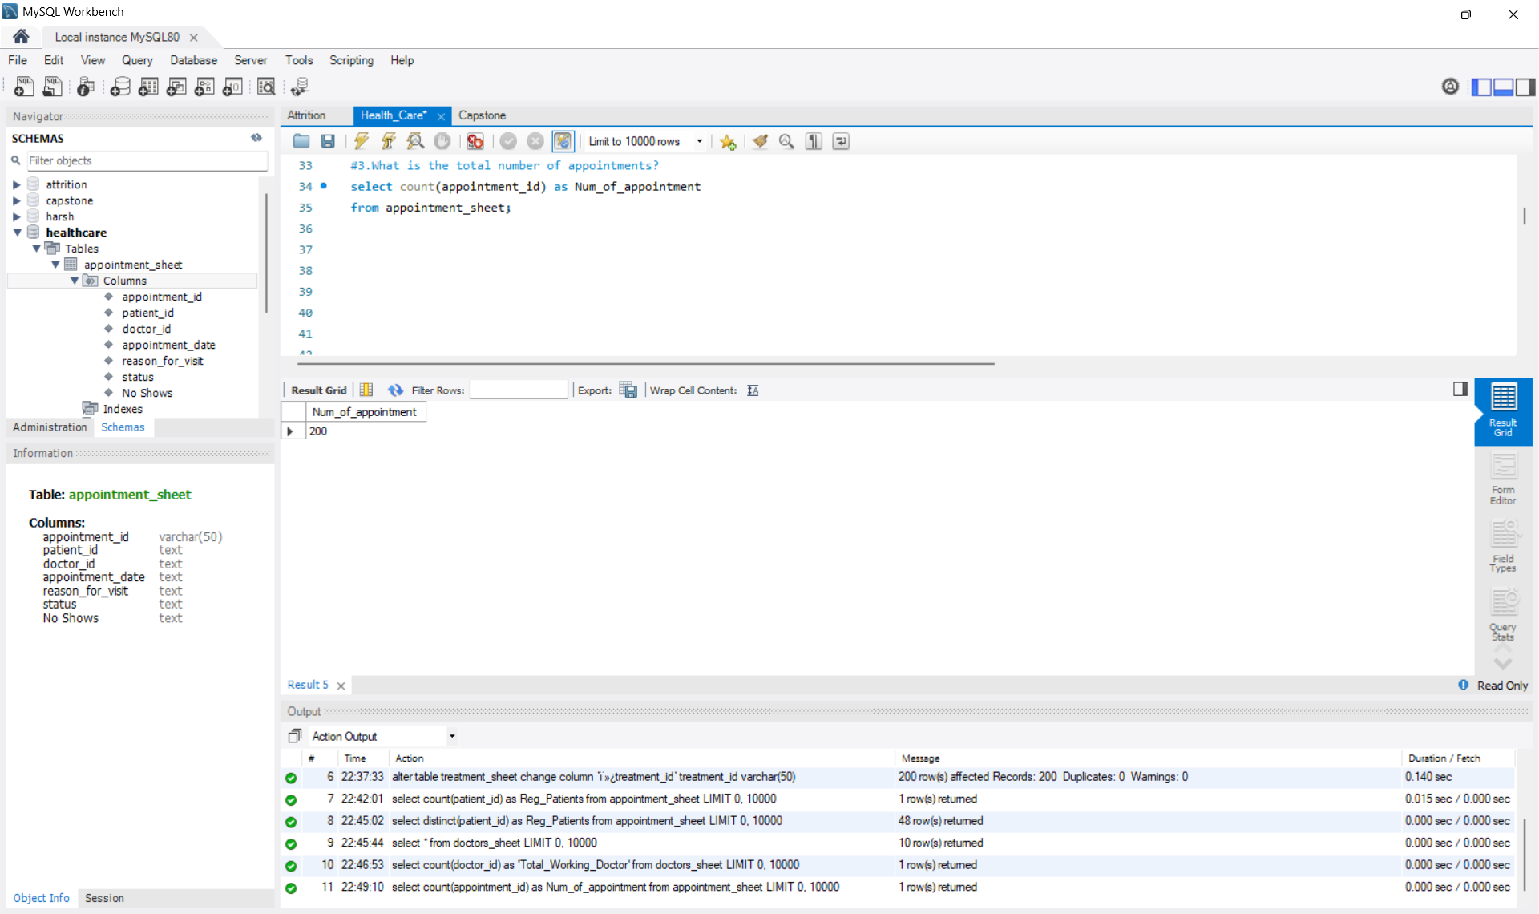

Slide 12
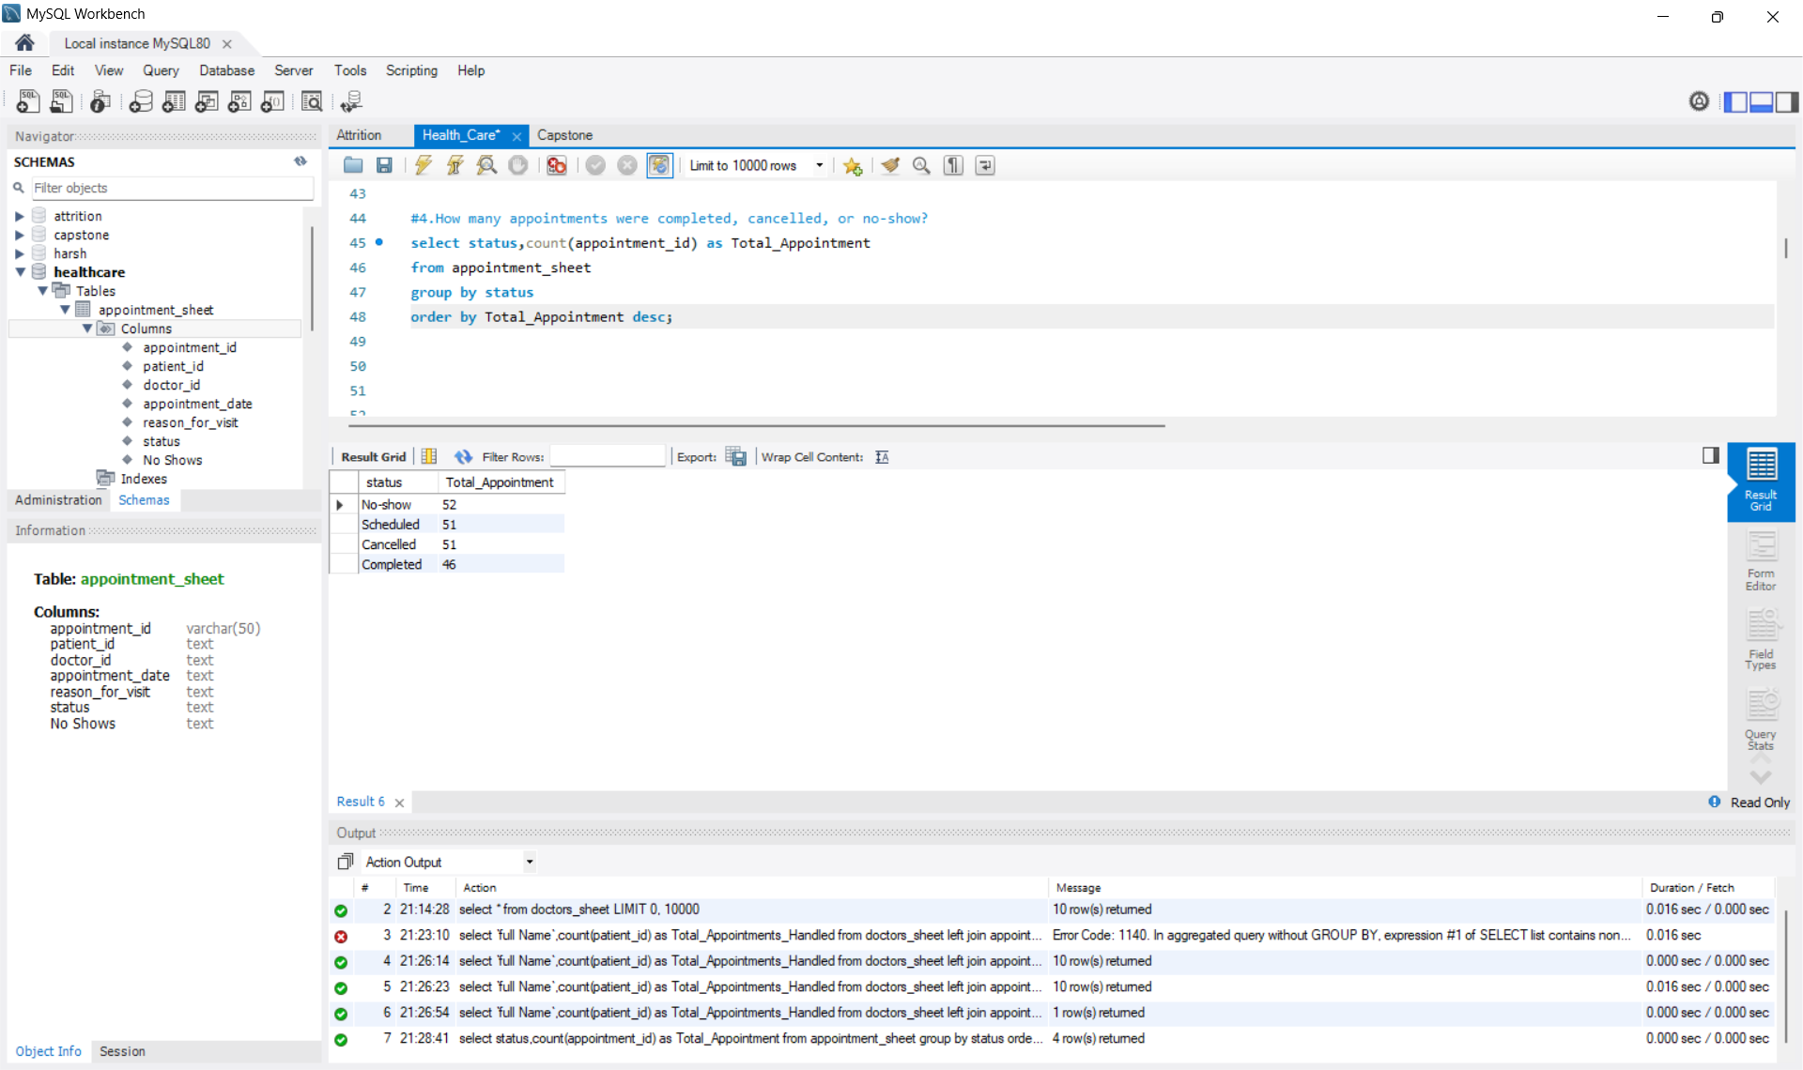

Slide 13
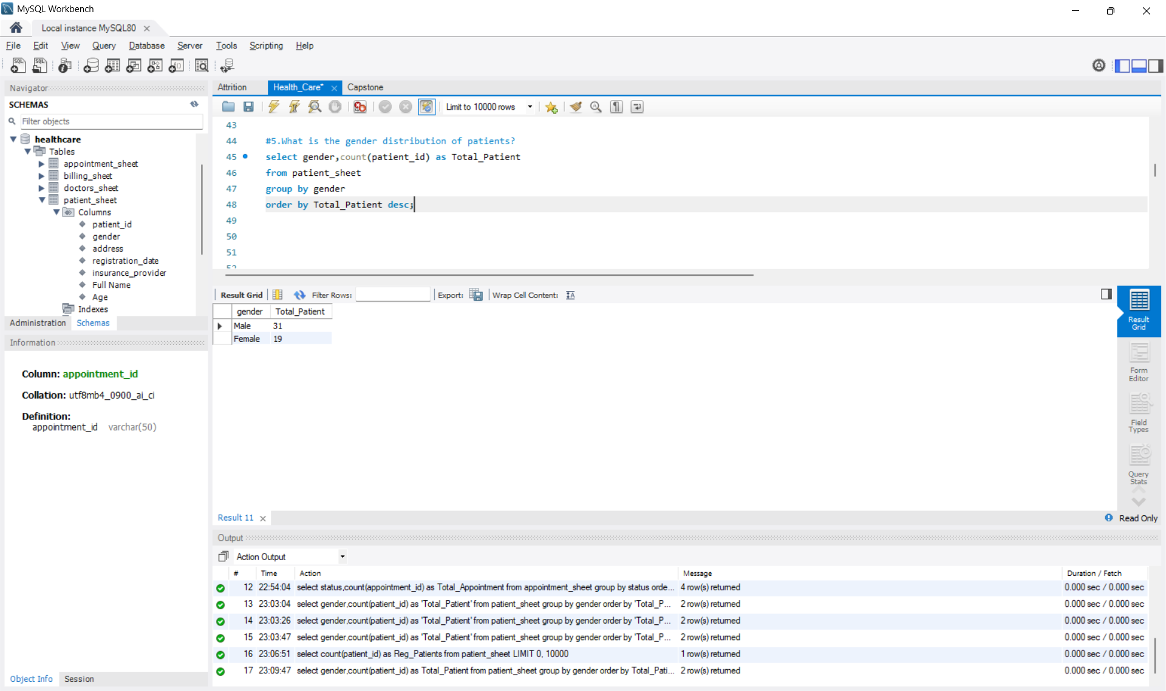

Slide 14
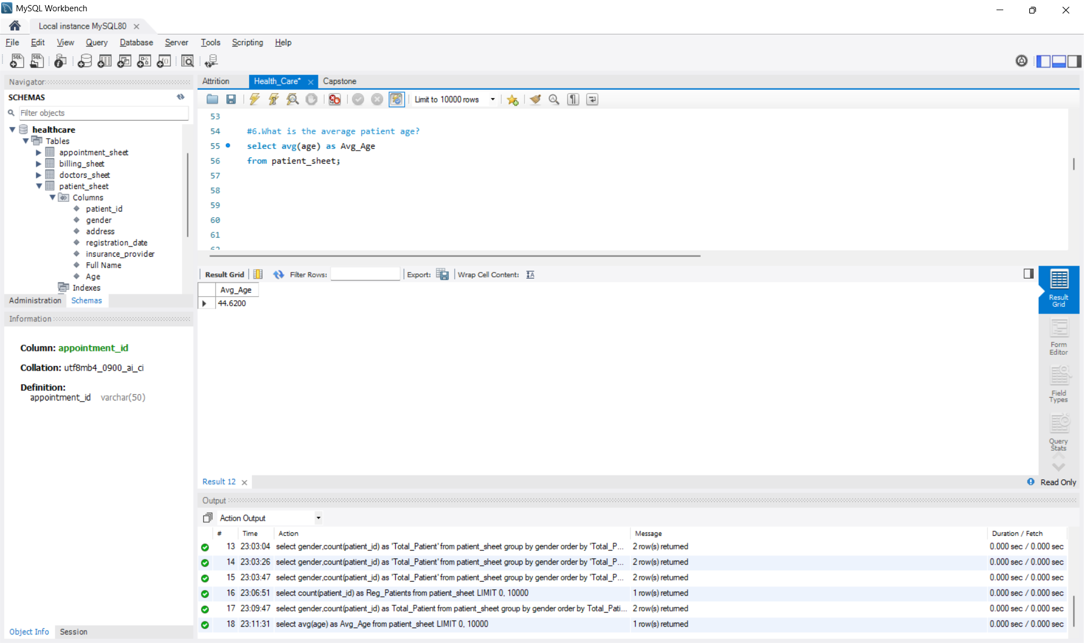

Slide 15
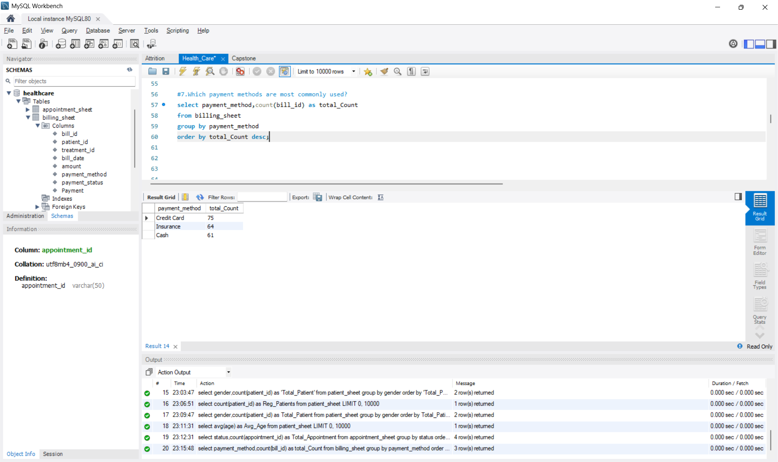

Slide 16


Slide 17
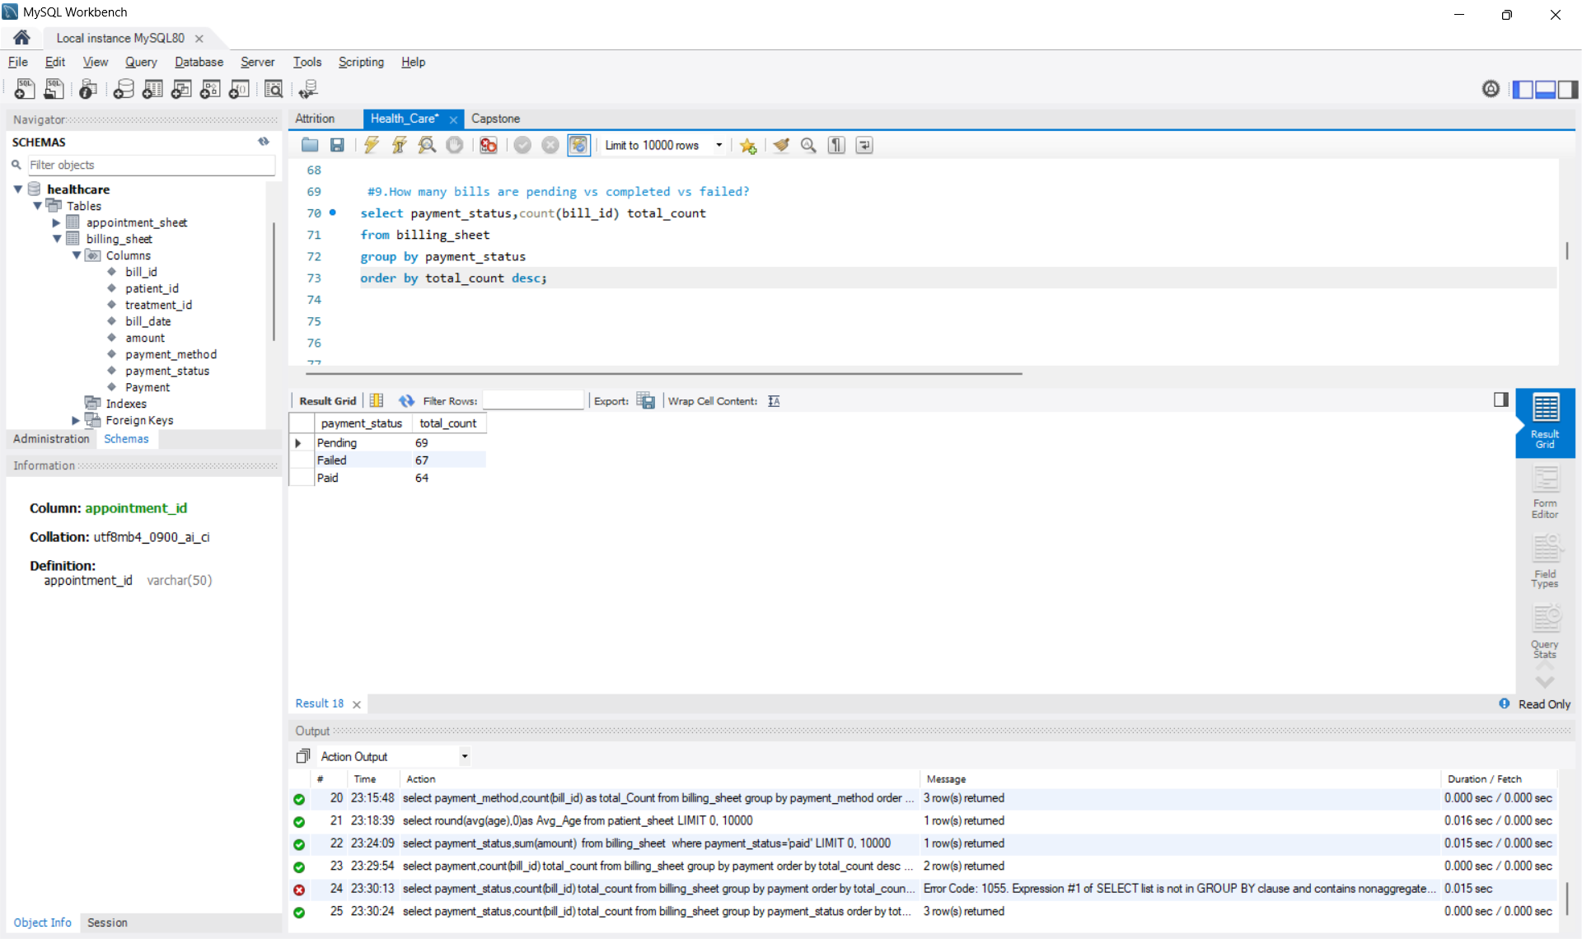

Slide 18
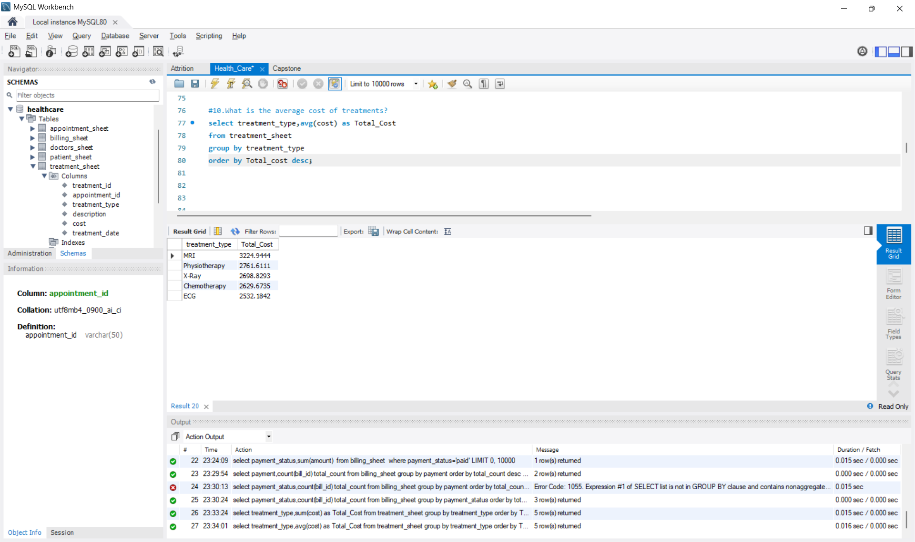

Slide 19
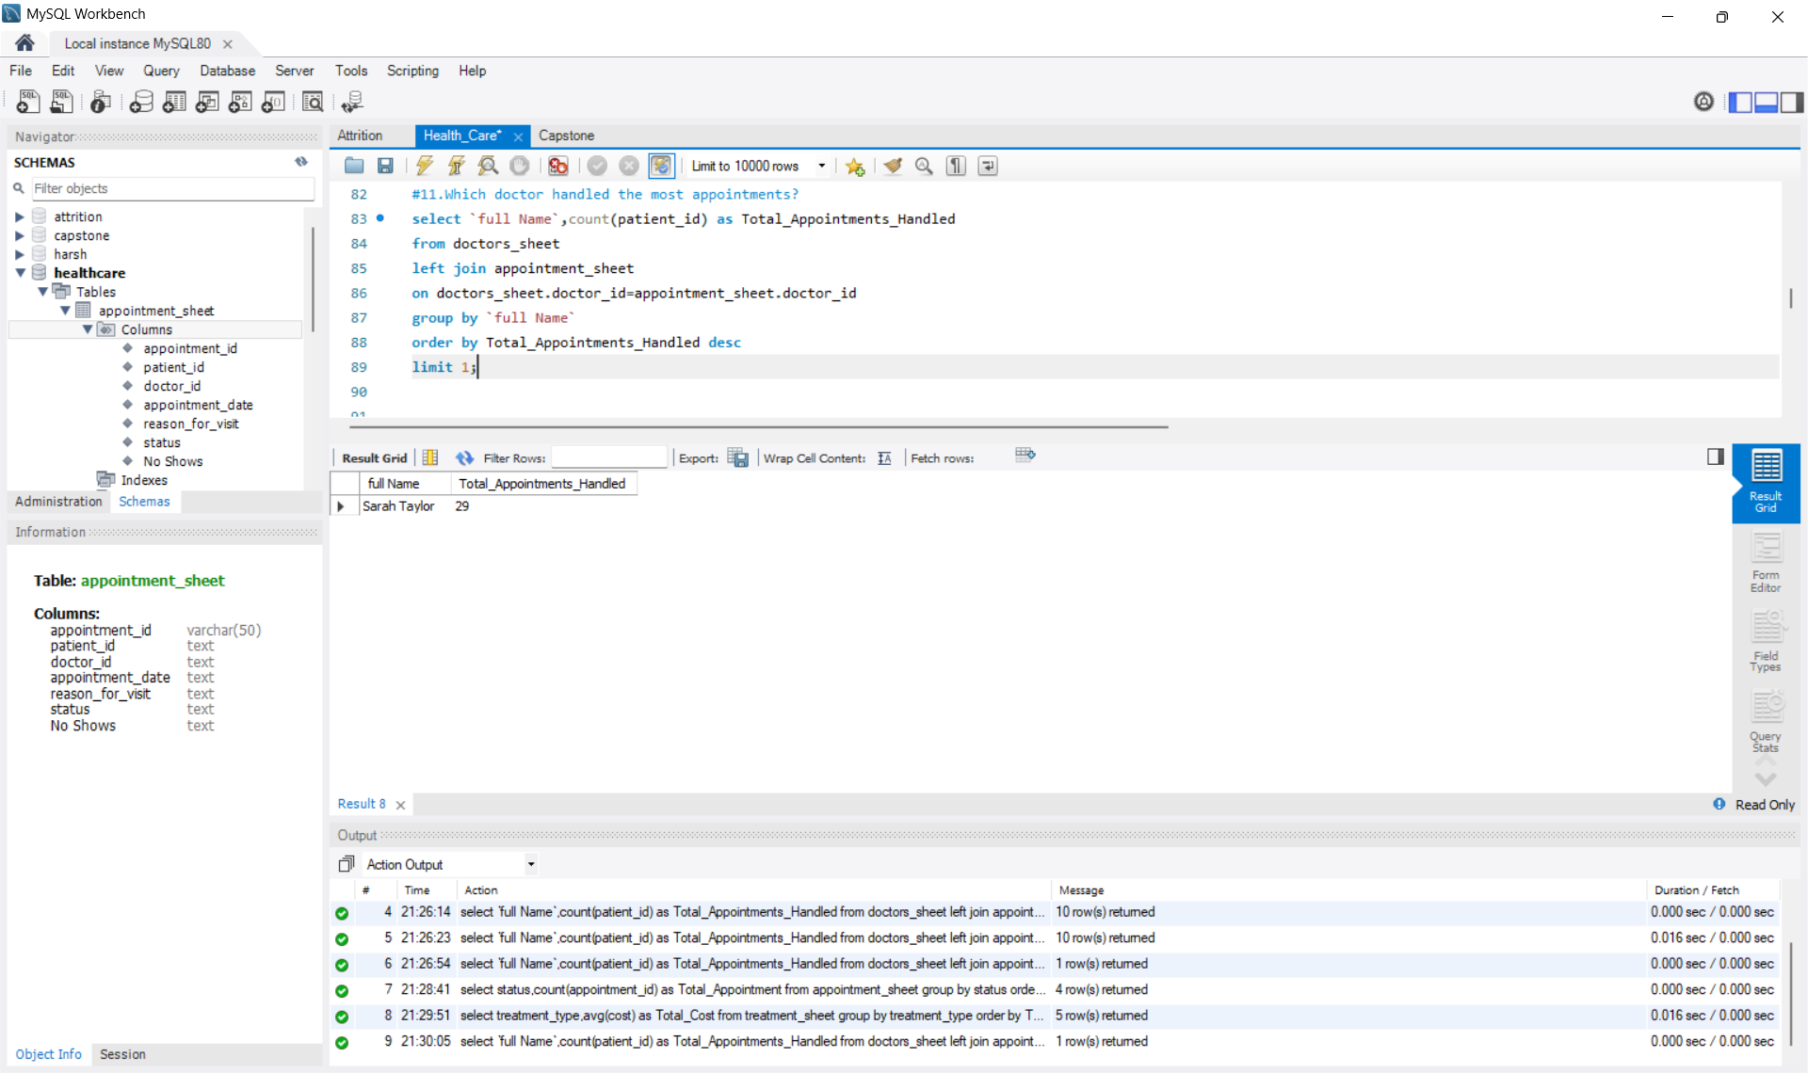

Slide 20
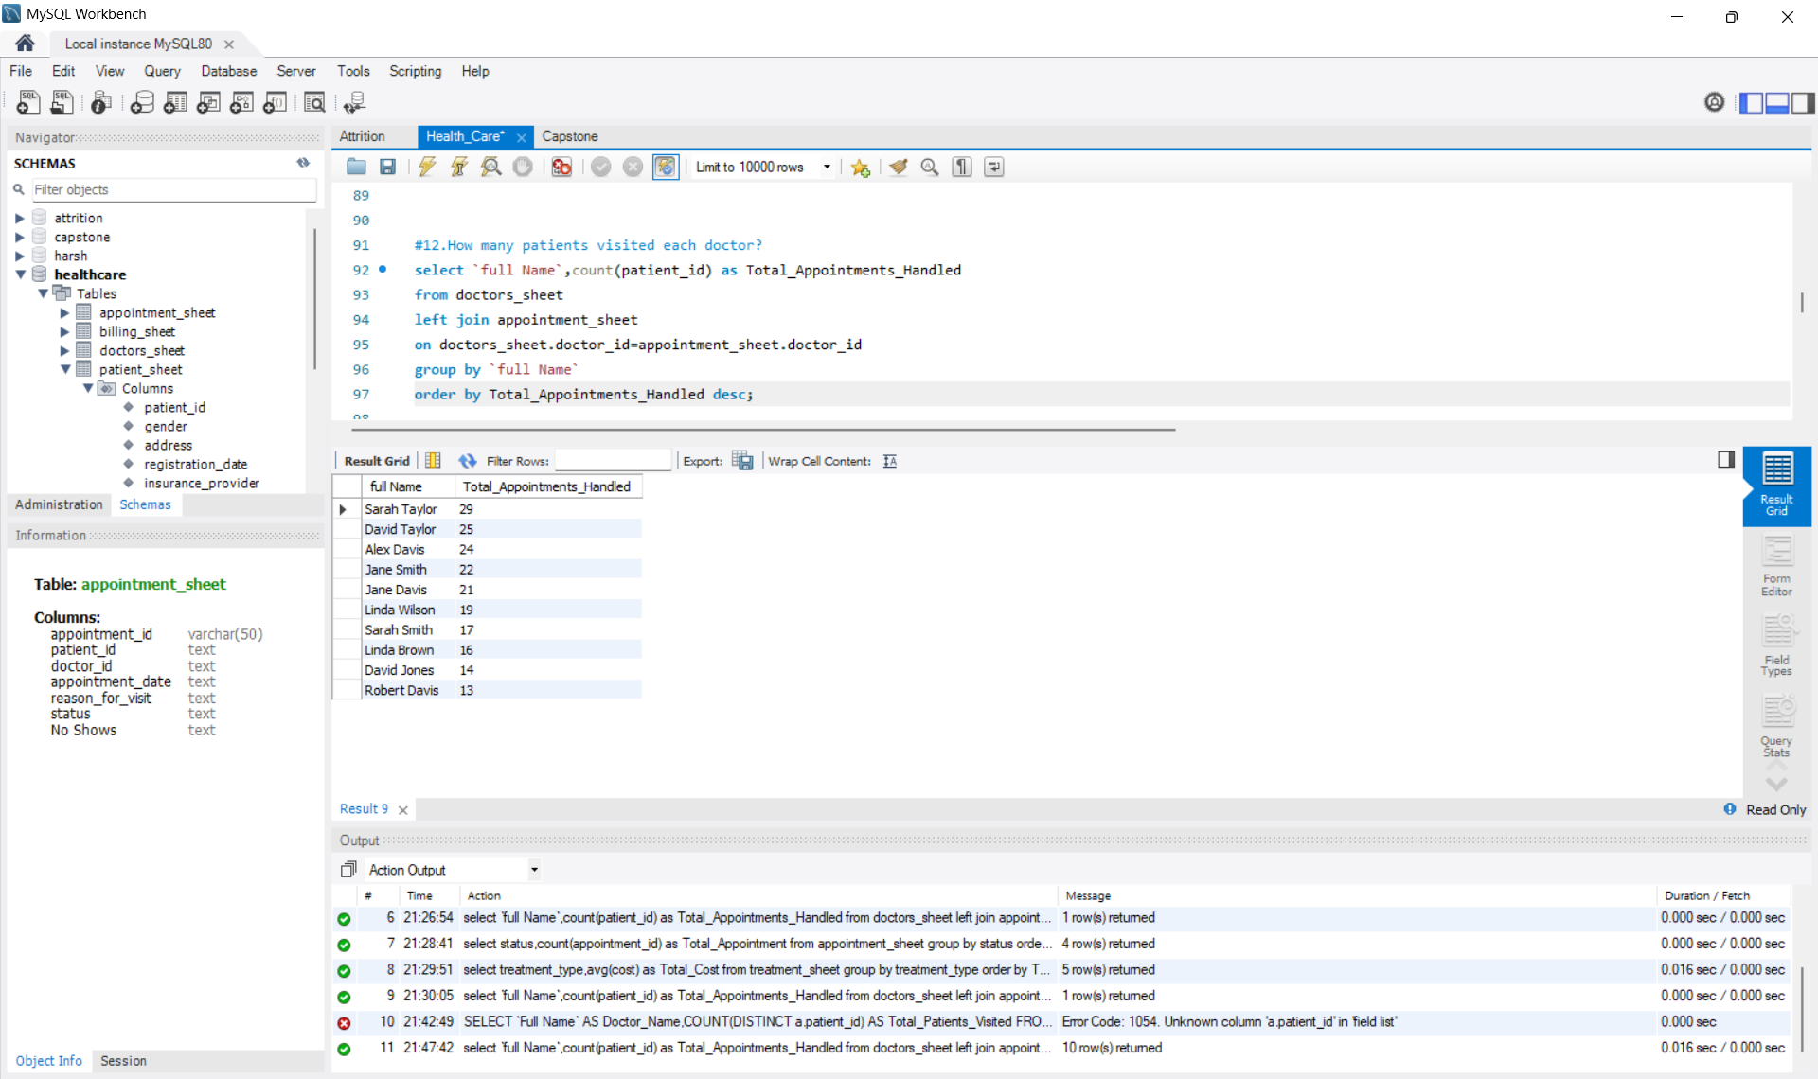

Slide 21
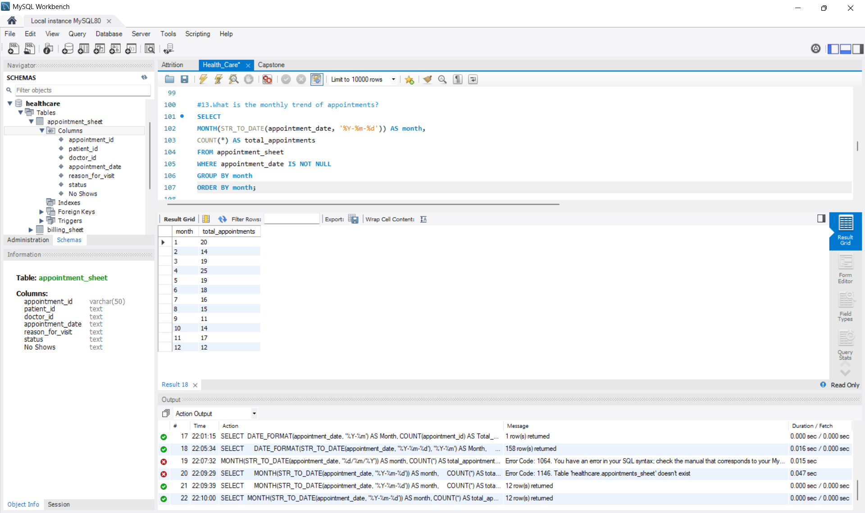

Slide 22
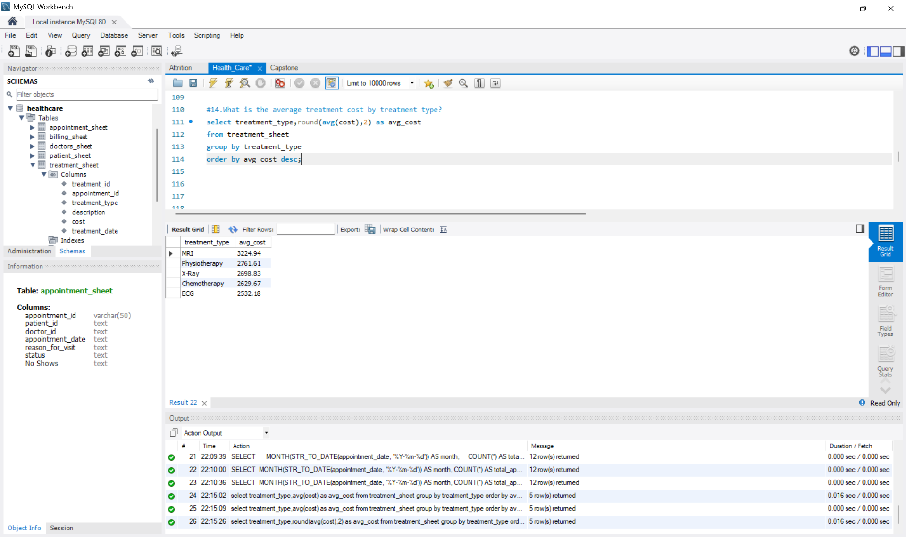

Slide 23
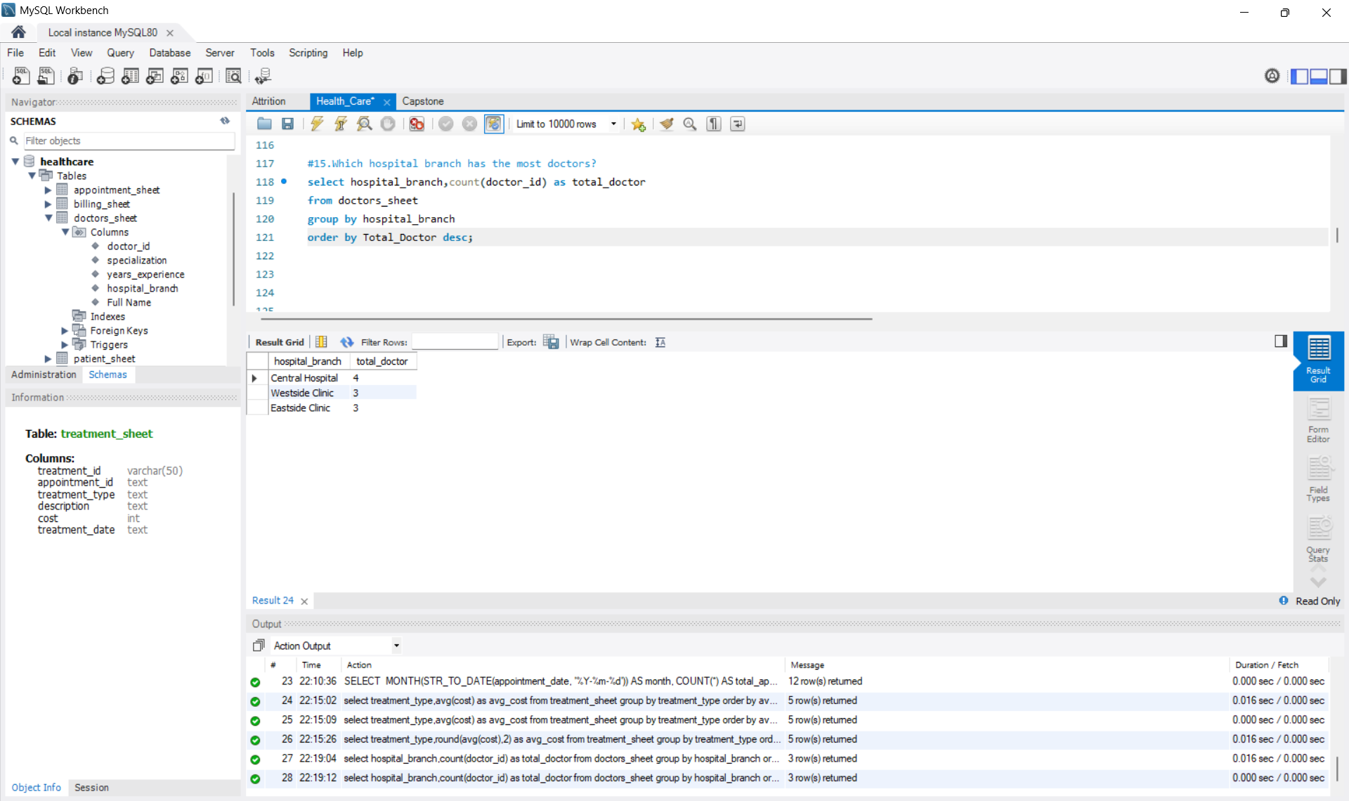

Slide 24
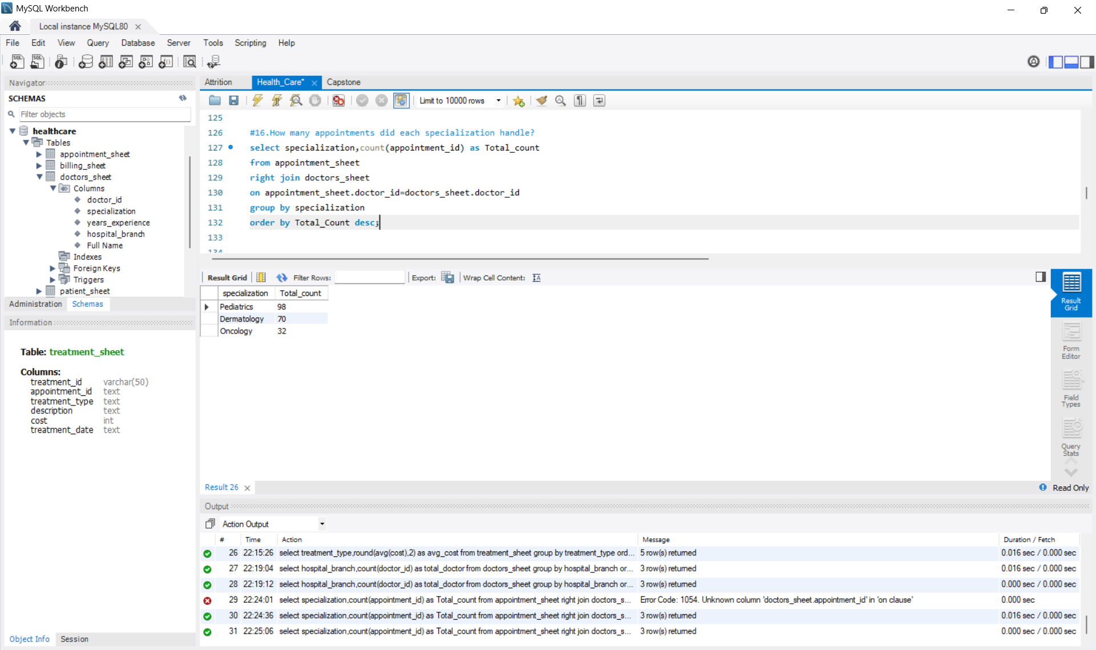

Slide 25


Slide 26
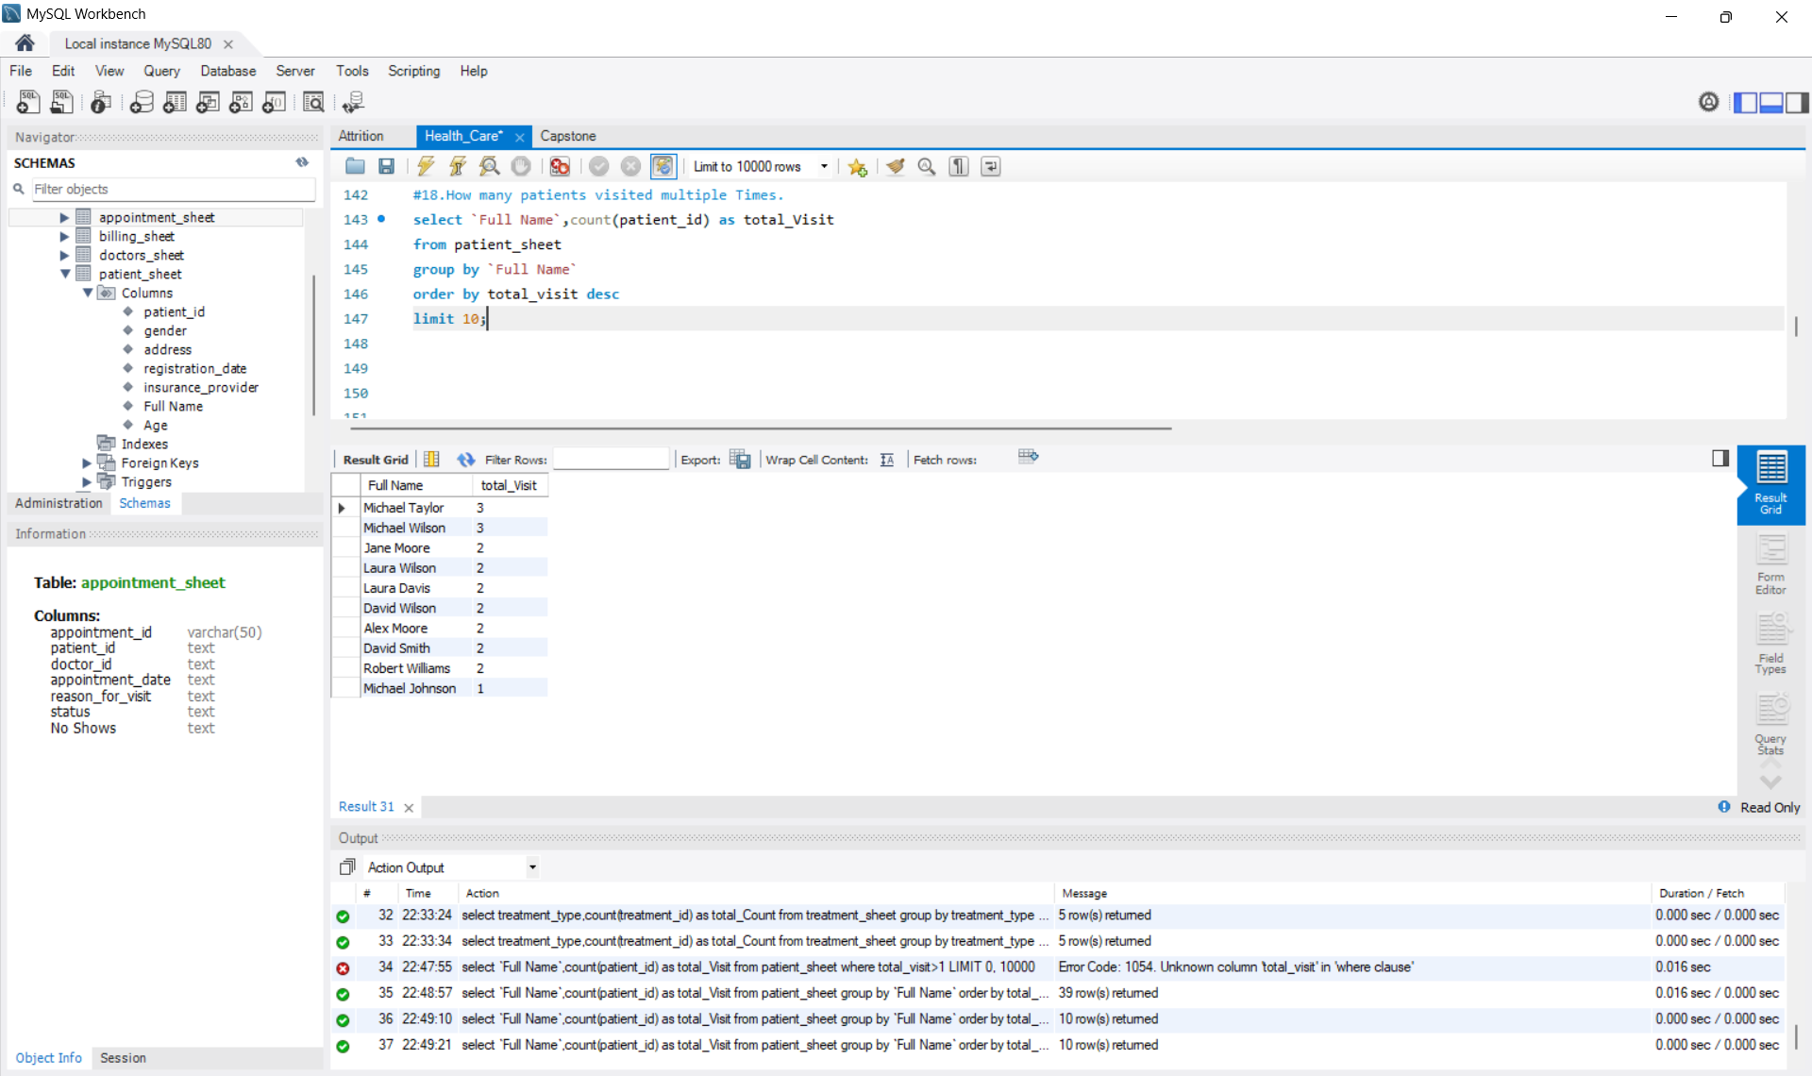

Slide 27
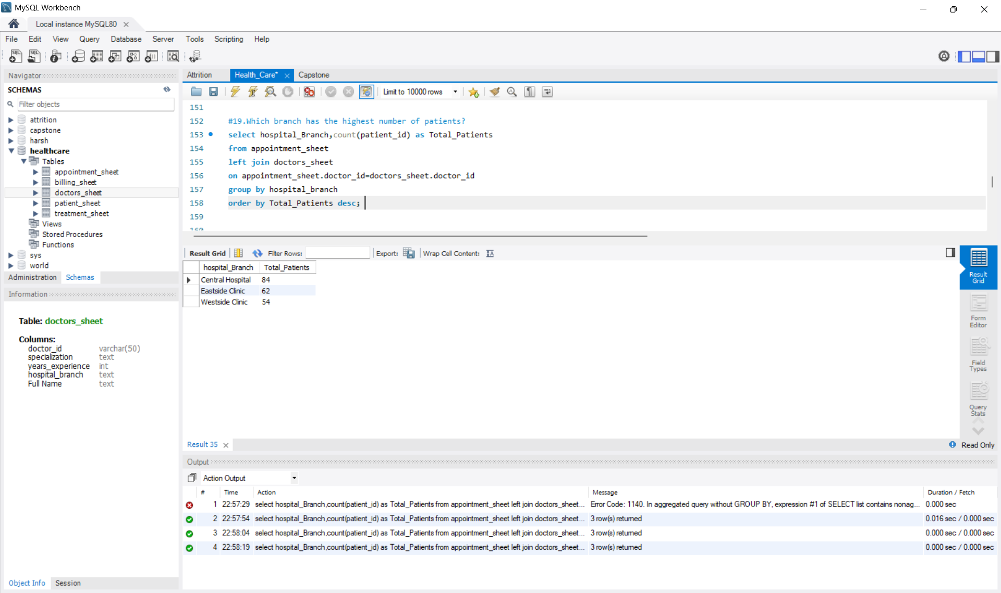

Slide 28
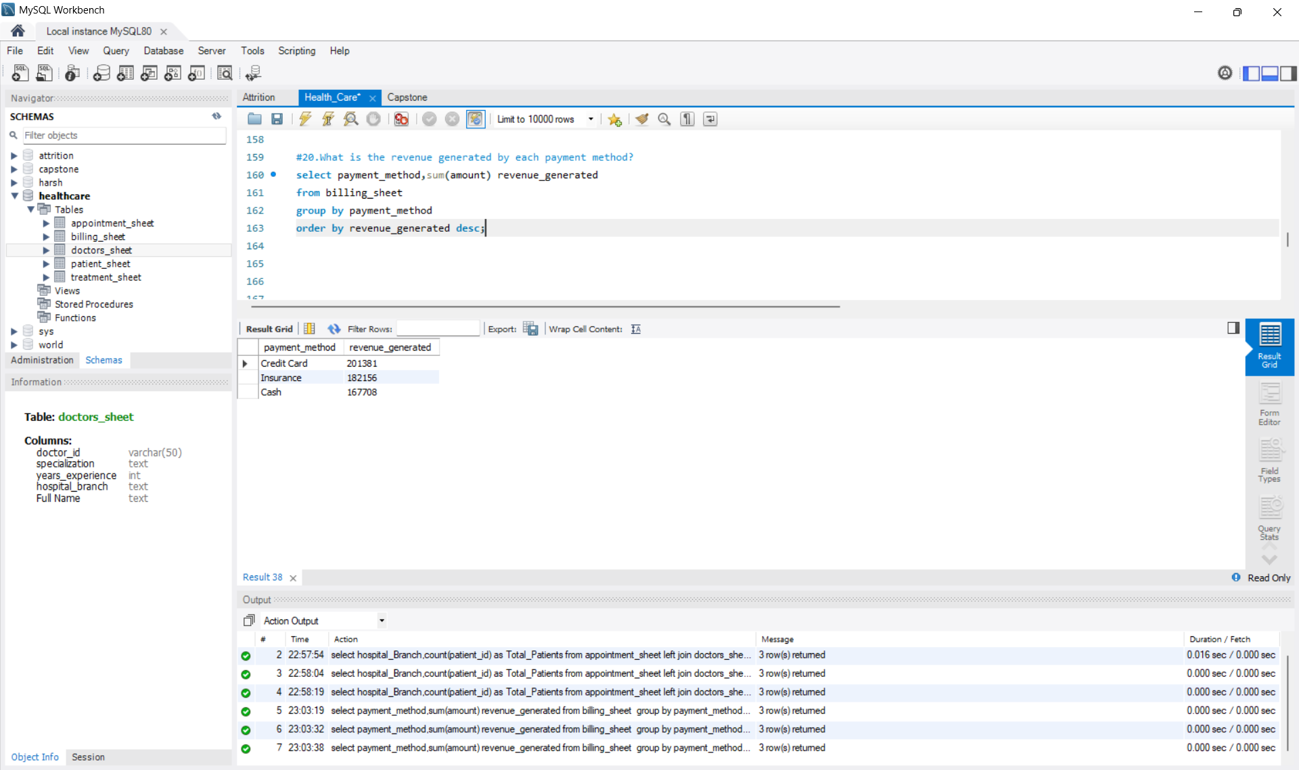

Slide 29
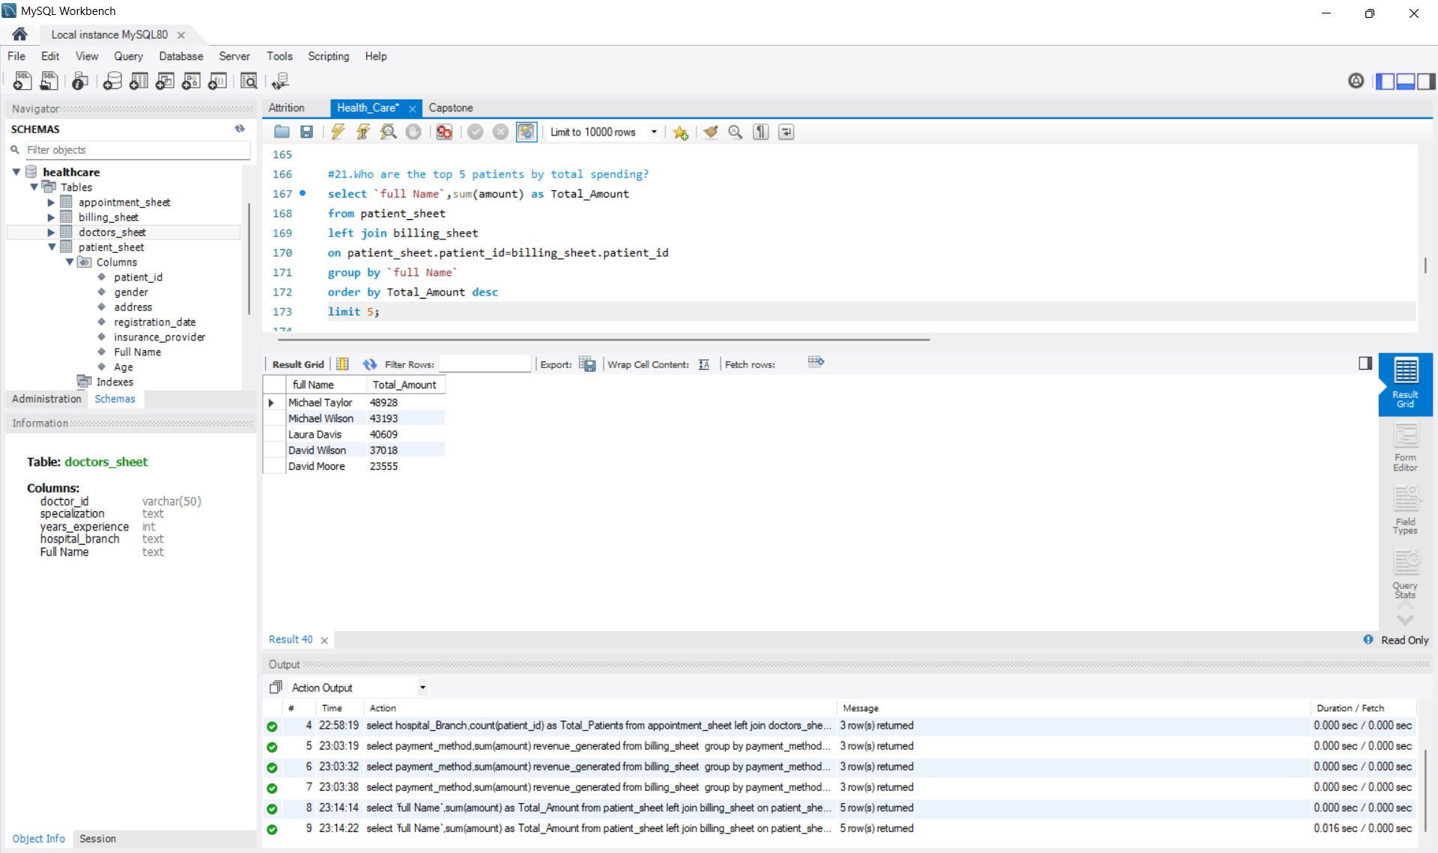

Slide 30
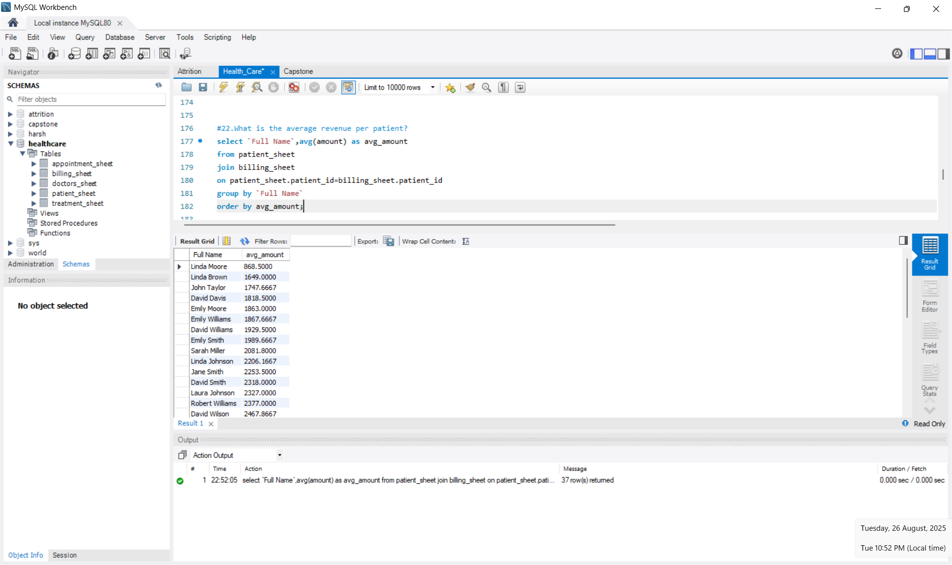

Slide 31
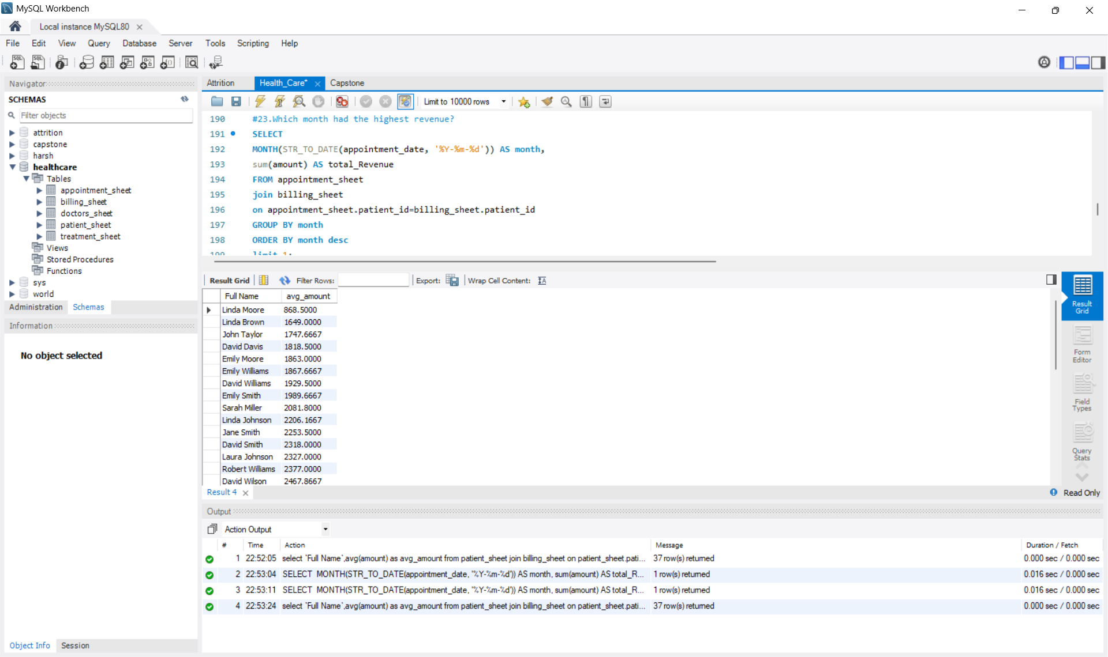

Slide 32
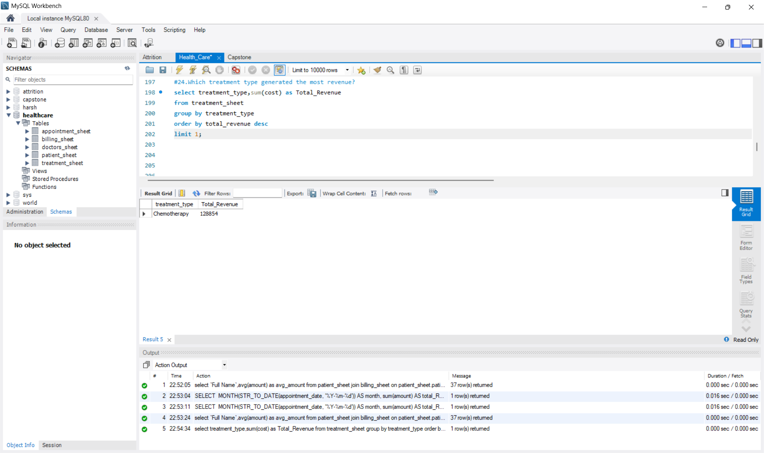

Slide 33
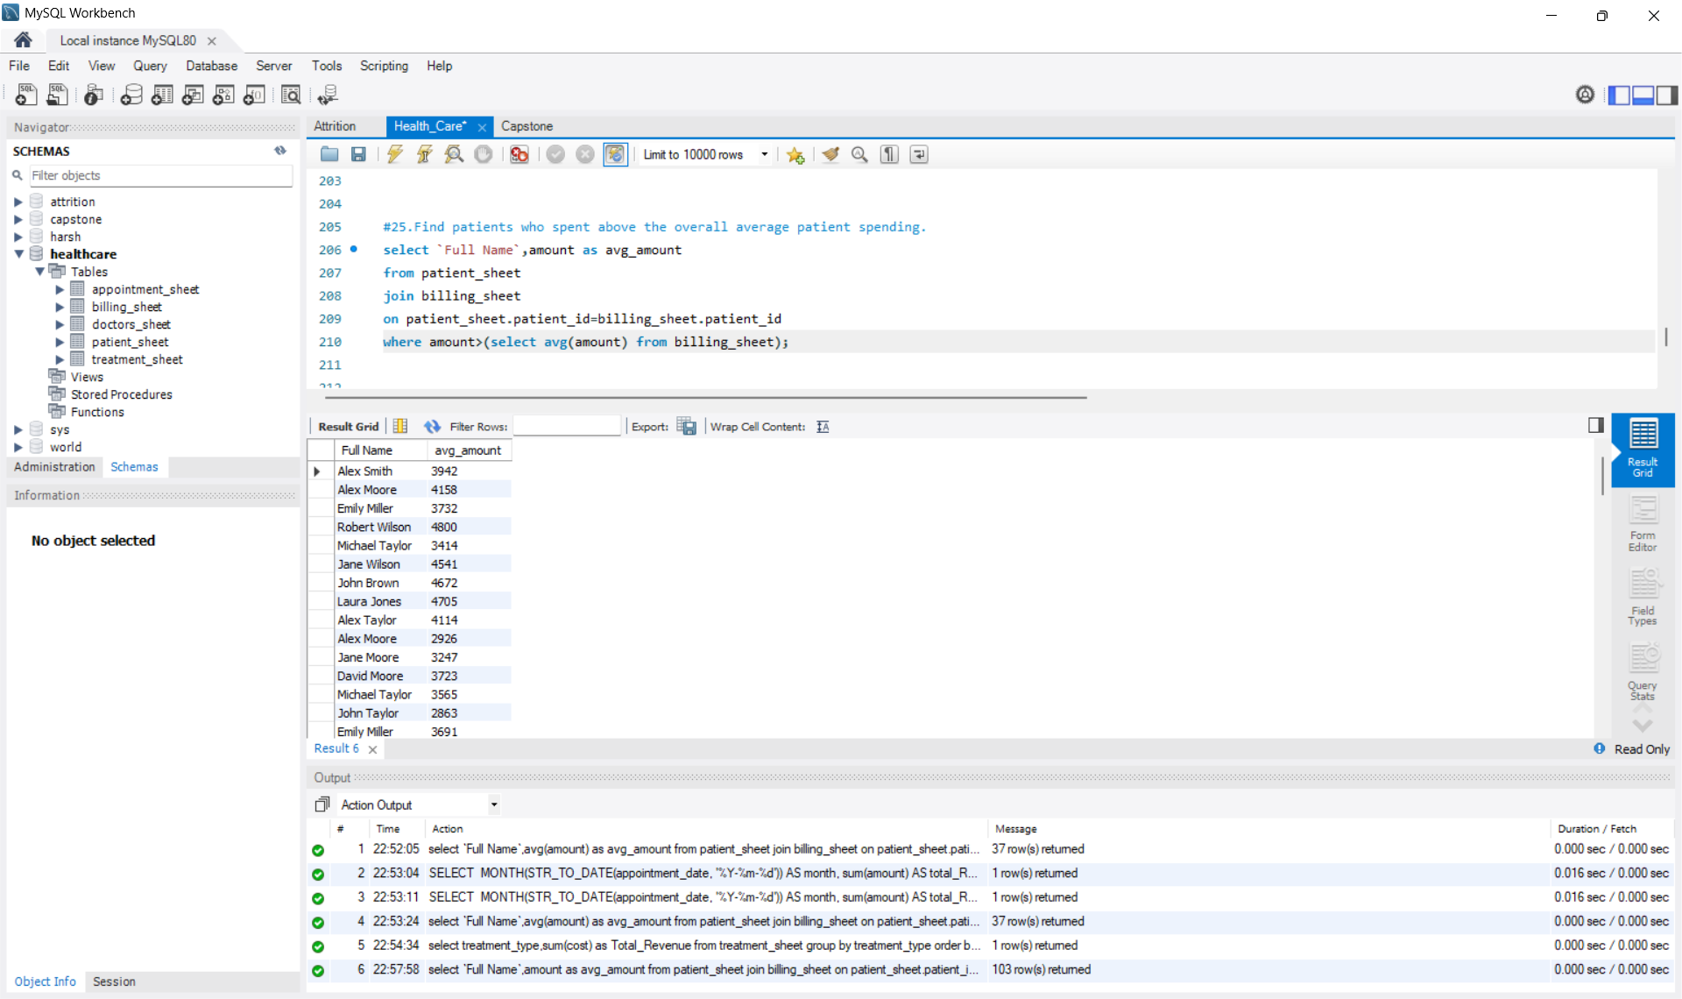

Slide 34
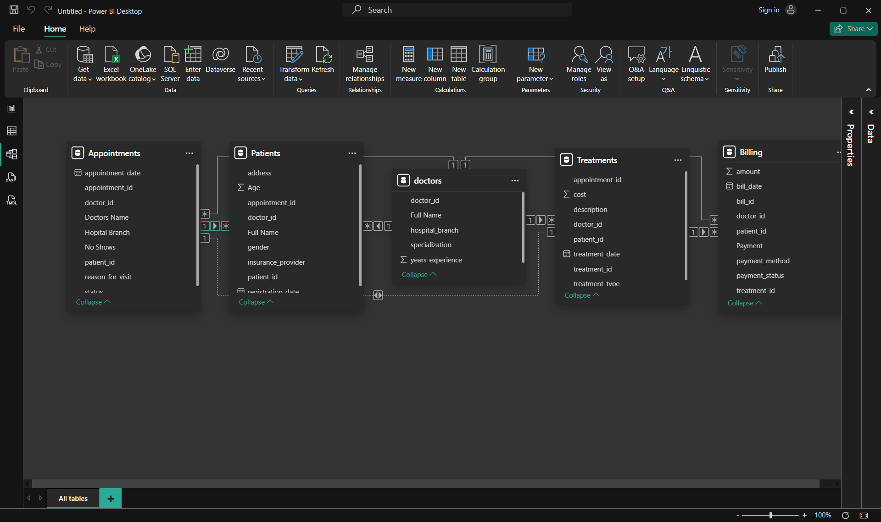
Import the Data Into Power bi. Verify if the data is properly Imported

Slide 35
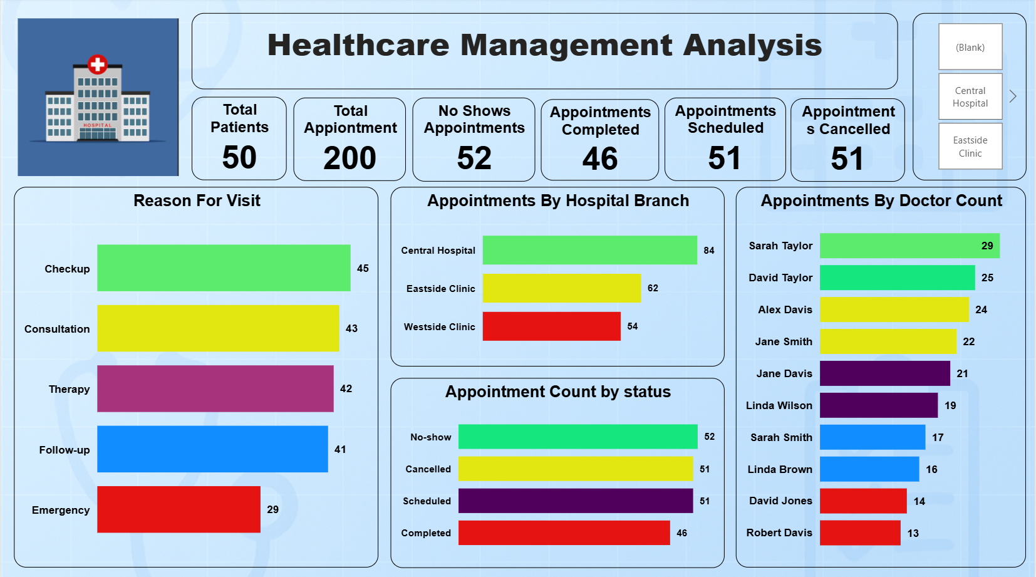
Make a Detailed Interactive Dashboard by using visualization tools such as PowerBI and Answer the following questions.

Slide 36
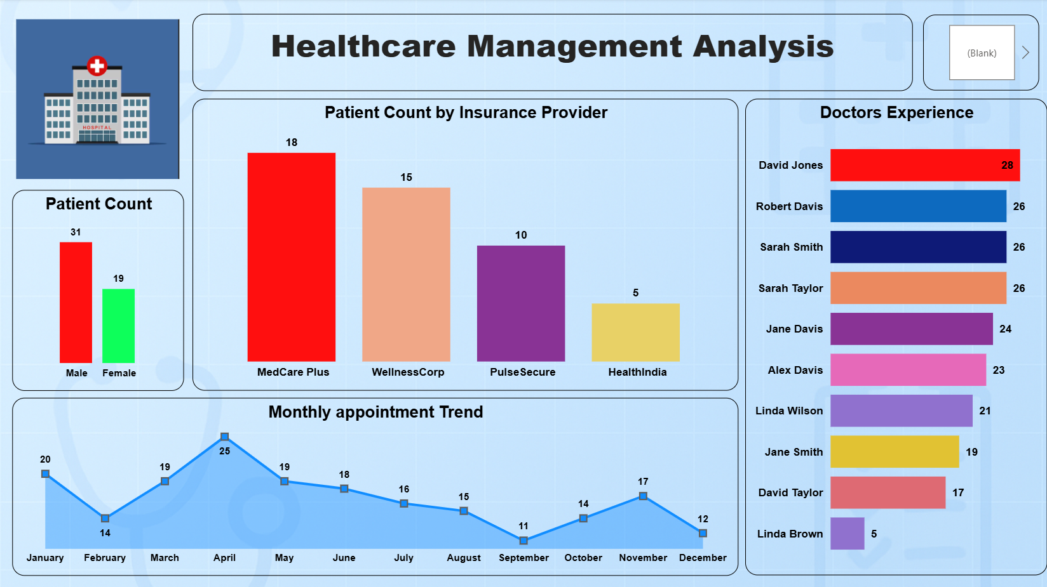

Slide 37
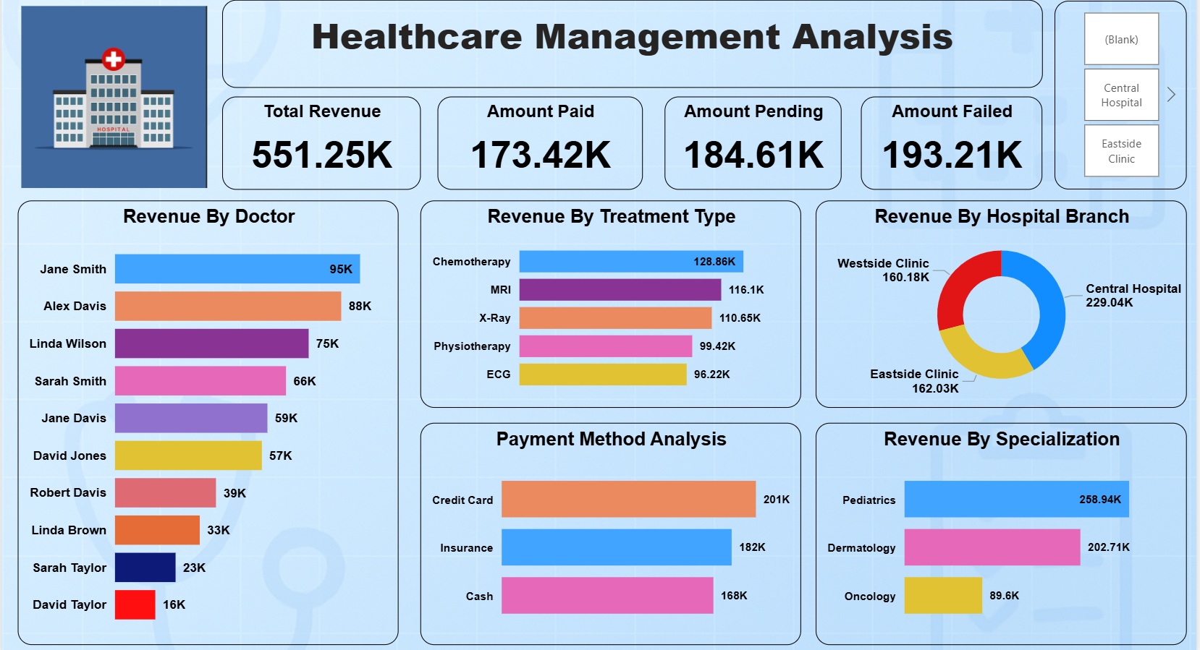

Slide 38
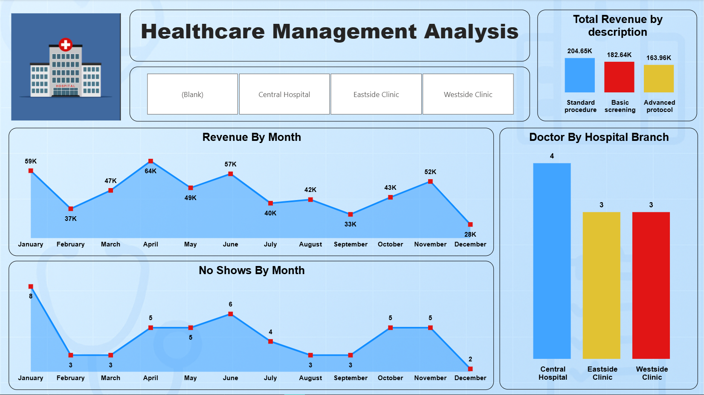

Slide 39
Derive Conclusion and Inferences from the Dashboard.
Conversion crisis in the appointment funnel
Out of 200 appointments: 52 no-shows (26%), 51 cancelled (26%), only 46 completed (23%).
That’s >50% lost before treatment—your biggest revenue leak.
Collections problem, not demand
Total revenue: 551.25K but only 173.42K paid (31%); 184.61K pending (33%) and 193.21K failed (35%).
Even without more patients, cashflow can improve massively by fixing billing.
Westside is most profitable per visit
Appointments: Central 84, Eastside 62, Westside 54.
Revenue: Central 229.0K, Eastside 162.0K, Westside 160.2K.
Revenue per appointment (≈K/visit): Central 2.73, Eastside 2.61, Westside 2.97 → Westside yields the highest value per slot despite the fewest visits.
Doctor mix is inefficient

Slide 40
Insights and Conclusions.
Highest appointments: Sarah Taylor (29) and David Taylor (25) but their revenue is 23K and 16K → ~₹0.64–0.79K/visit (lowest).
Jane Smith (22 appts) drives 95K (≈4.32K/visit). David Jones has only 14 appts but ≈4.07K/visit.
You’re giving too many slots to low-yield profiles.
What drives money
By specialization: Pediatrics (258.9K) > Dermatology (202.7K) >> Oncology (89.6K).
By treatment: Chemo (128.9K), MRI (116.1K), X-Ray (110.7K), Physio (99.4K), ECG (96.2K).
By procedure description: Standard procedures (204.7K) lead; Advanced protocol (164.0K) lags—possible under-conversion from screening to advanced care.
Seasonality & show-up behavior
Revenue peaks Apr (64K) & Jun (57K); dips Sep (33K) & Dec (28K).
No-shows peak Jan (8) & Jun (6); trough Dec (2) → calendar aware interventions matter.

Slide 41
Insights and Conclusions.
Payer & method mix
MedCare Plus is top insurer; payment split is fairly even (Card 201K, Insurance 182K, Cash 168K).
Without denial/aging breakdowns, failure hotspots are unclear—likely an upstream eligibility/claims issue.
Patient profile
Male 31 vs Female 19 → opportunity to grow women’s health segments.
Visits are largely Checkup/Consult/Therapy/Follow-up (41–45 each) → great base for continuity programs.

Slide 42
Solutions.
A) Fix the funnel (largest ROI)
24–48 hr WhatsApp/SMS reminders + “tap-to-confirm” link; auto-reschedule if no response.
Same-day waitlist + 10–15% smart overbooking in hours where no-show rate is highest (Jan/Jun; Mon/Tue mornings—verify).
Tele-visit fallback for follow-ups/consults. Impact math: 30% fewer no-shows (~15 visits) at ~2.76K/visit ≈ +43K/month; 20% fewer cancellations ≈ +28K/month.
B) Collect the cash you already earned
Pre-auth cards/UPI, eligibility check before high-ticket MRI/Chemo;
Denial management: track claim reasons, first-pass acceptance %, and resubmission SLAs;
Automated dunning (T+3, T+7, T+14) with payment links; offer EMI for >10K bills. Impact math: Cut failed by 25% → +48K; clear pending by 30% → +55K realized.

Slide 43
Solutions.
C) Rebalance scheduling to revenue per appointment (RPA)
Route high-value procedures/new referrals to Jane Smith, David Jones, Linda Wilson, Sarah Smith (all ≥3.8K/visit).
Move high-volume/low-value screenings to Sarah/David Taylor; shorten slot length for them to increase throughput.
Publish transparent lead times so high-value doctors get filled first. Bonus: +10 extra Westside visits/month at 2.97K ≈ +30K.
D) Grow what works
Pediatrics & Dermatology: add evening clinics/camps; bundle (Checkup → Screening → Advanced) care paths; track conversion rates between steps.
Women’s health drive (PCOS/thyroid/skin): targeted campaigns to close the gender gap.
E) Seasonal playbook
Jan & Jun: double reminders, flexible rescheduling, and small ₹100 pre-book deposit (waived on show).
Sep & Dec dips: corporate checkup tie-ups, school health camps, vaccine drives.
F) Data hygiene quick wins
Fix (Blank) in branch slicer; standardize doctor names; ensure one row per appointment/treatment; capture payment_status consistently.

